Slide 1
APP USER GUIDE
BRITE™ By ASI

Slide 2
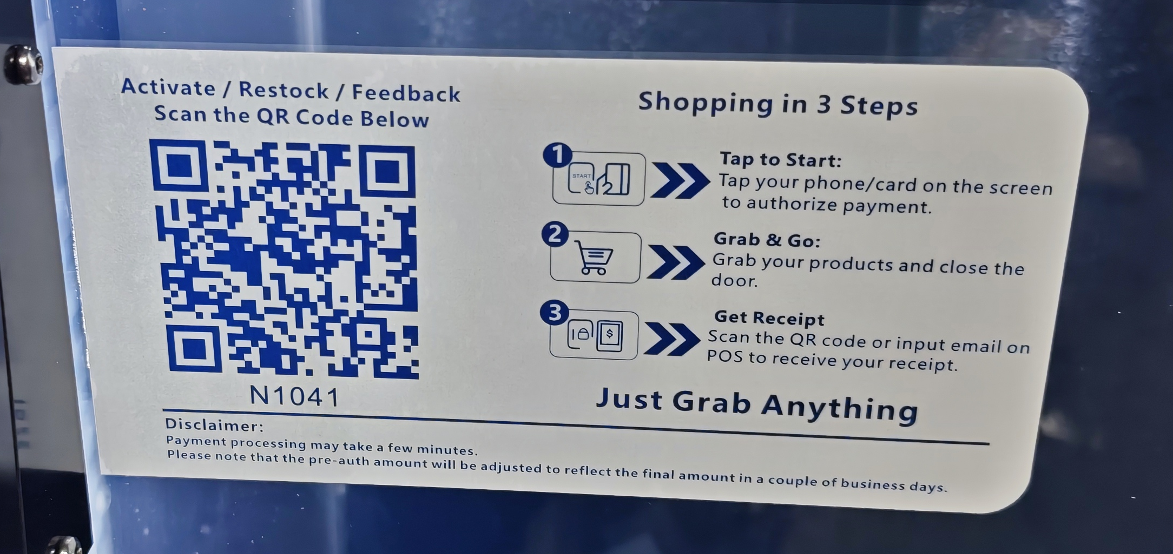
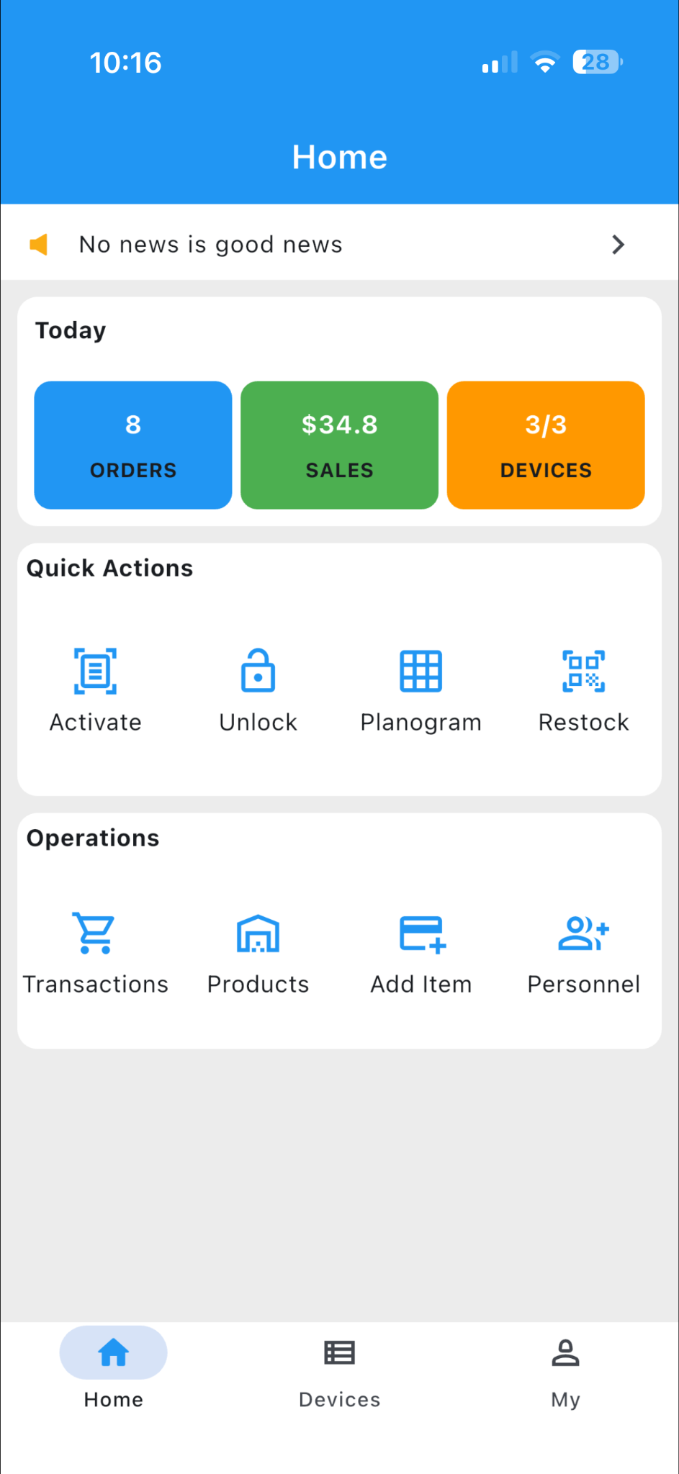
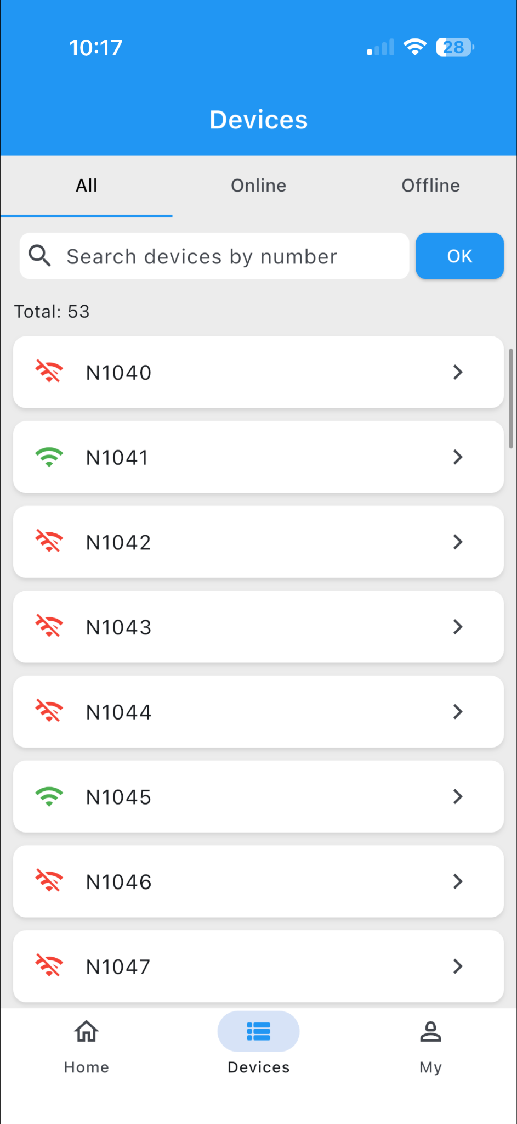
1.1 Device Activation
Tap the “Activate” icon on the home screen to open the scanner.
Scan the QR code located on the device (see Figure 1-1-1) to begin activation (Figure 1-1-2).
Figure 1-1-1 Equipment QR code
Once the activation is successful, the device will be ready for use.
You can view the activated device details in the Devices section at the bottom of the screen (Figure 1-1-3).
At the top of this section, you can filter devices by online status or device ID.
Each device ID is shown with a Wi-Fi icon:
Red means the device is offline
Green means the device is online
Before performing any further operations, please make sure the device is online.
Figure 1-1-2 Activation equipment
Figure 1-1-3 Equipment

Slide 3

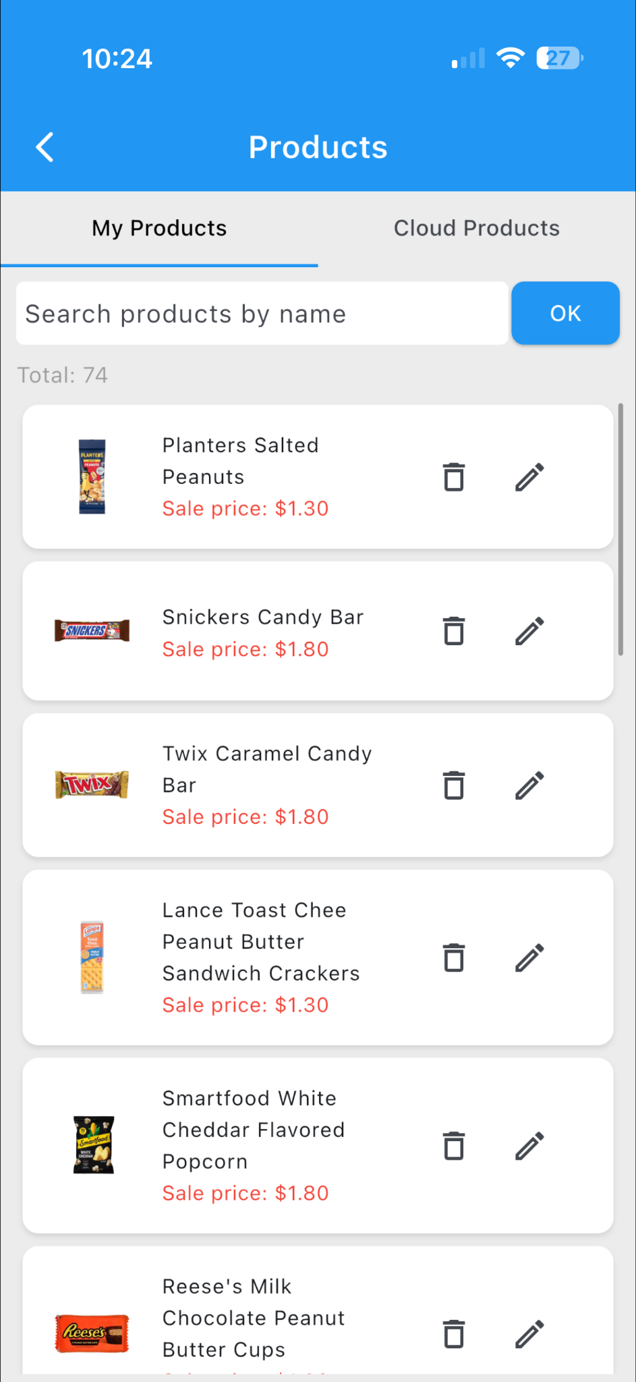
1.2 Setting Up Your Product Library
Tap the “Products” icon to open the product library page (see Figure 1-2-1).
After clicking “ Products” , the next page shows:
My Products shows all items currently in your local Library. (Figure 1-2-2).
Cloud Products refers to the shared cloud product database (Figure 1-2-2).
To add a new product from cloud products, tap the “+” button to open the product creation page.
Enter the selling price and cost price, then save or submit the configuration.
Once saved, the selected products from the cloud database will appear in your store’s inventory upon notice.
Figure 1-2-1 Products library Figure 1-2-2 Local library

Slide 4
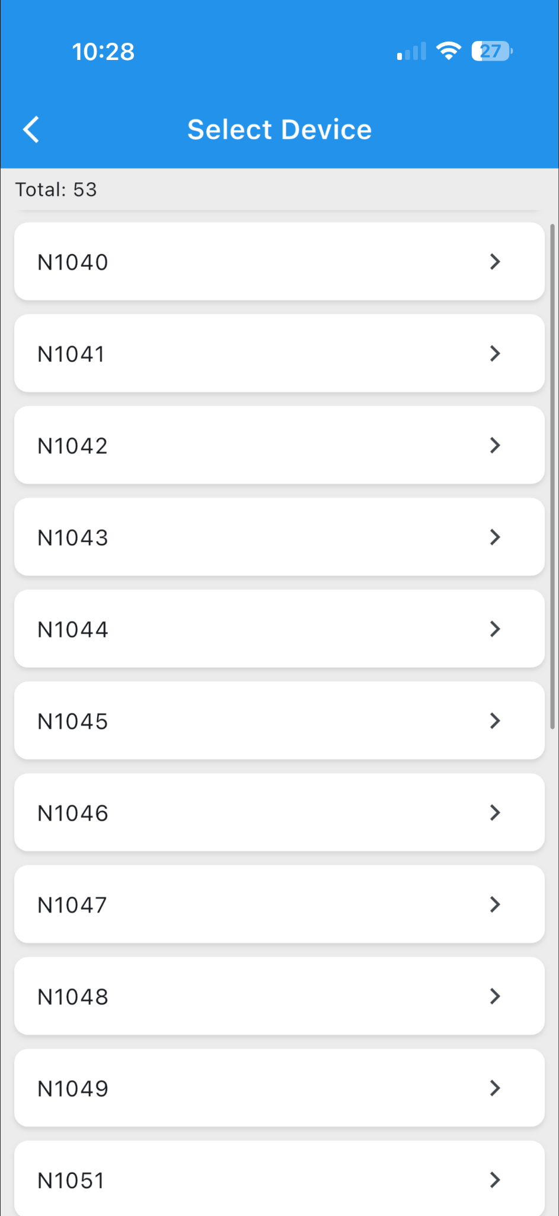
1.3 Configuring the Products for each machine
1.3.1 Template Setup and Description
Tap the “Planogram” button on the app’s home page (see Figure 1-3-1-1) to open the device selection page (Figure 1-3-1-2).
Figure 1-3-1-1 Configuration entry
Figure 1-3-1-2 Selecting equipment

Slide 5
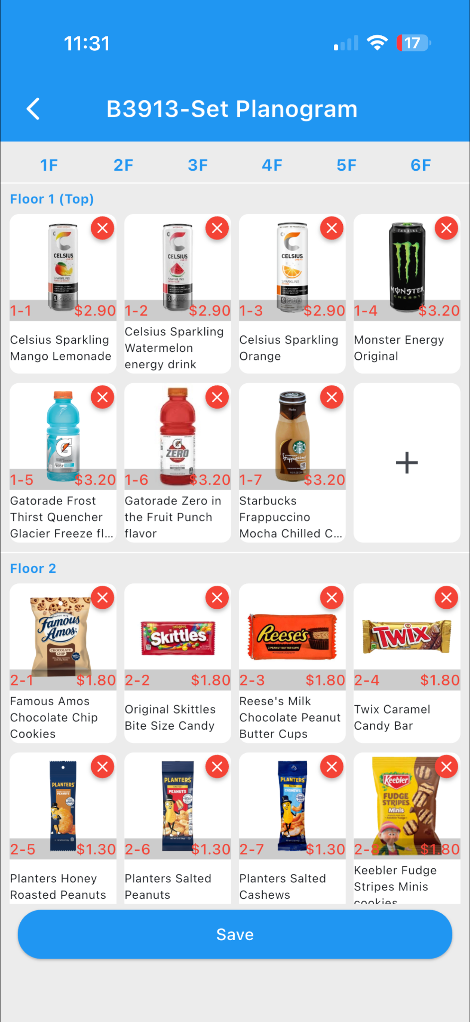
1.3.2 Template Configuration Notes
* Each layer in the device must strictly match the product arrangement set in the template during loading.
* If any layer is missing a corresponding product configuration, the system may fail to recognize the item correctly, which could result in operational errors or product loss.
* It’s recommended to place products with similar colors or shapes on different layers to help the system distinguish them more easily.
* If highly similar products are placed on the same layer, it may reduce the accuracy of product identification.
Figure 1-3-1-3 Template configuration

Slide 6
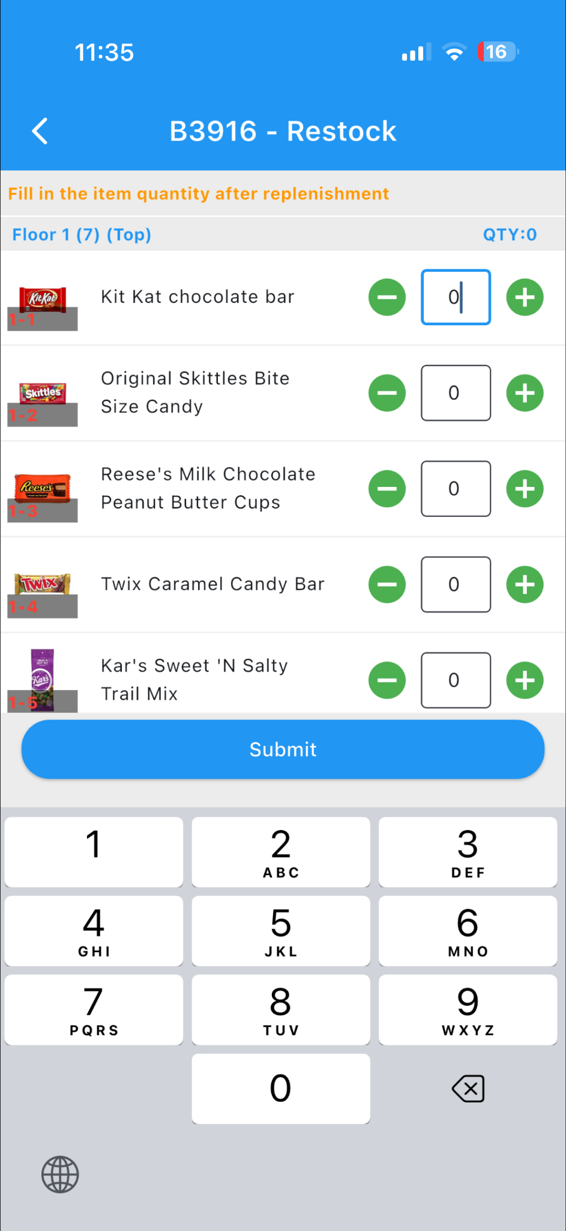
1.4 Replenishment
1.4.1 Assign Personnel
For information on assigning and managing restocking staff, please refer to Personnel
1.4.2 Scan to Restock
Function Overview:
Authorized restocking staff can log in to their account, use the Restock function in the app to scan the device’s QR code, unlock the door, and submit the replenished product quantities once the process is completed.
Access Path:
App Home Page → Restock (see Figure 1-4-2-1)
Operation Steps:
1. Tap “Restock” to activate the scan-to-replenish function.
2. Scan the QR code on the vending device to unlock the door. (see Figure 1-1-1)
After the door opens, the app automatically redirects to the Replenishment Interface (Figure 1-4-2-2).
Restock the products on each shelf according to the preconfigured planogram.
Note: The planogram must be set up in advance with available products before restocking.
During or after restocking, enter the overall quantity of items for each shelf level (i.e., the total number of items per layer).
Once finished, close the interface and tap “Submit” to save and sync the replenishment record.
Figure 1-4-2-1 Scan to restock Figure 1-4-2-2 Restock page

Slide 7
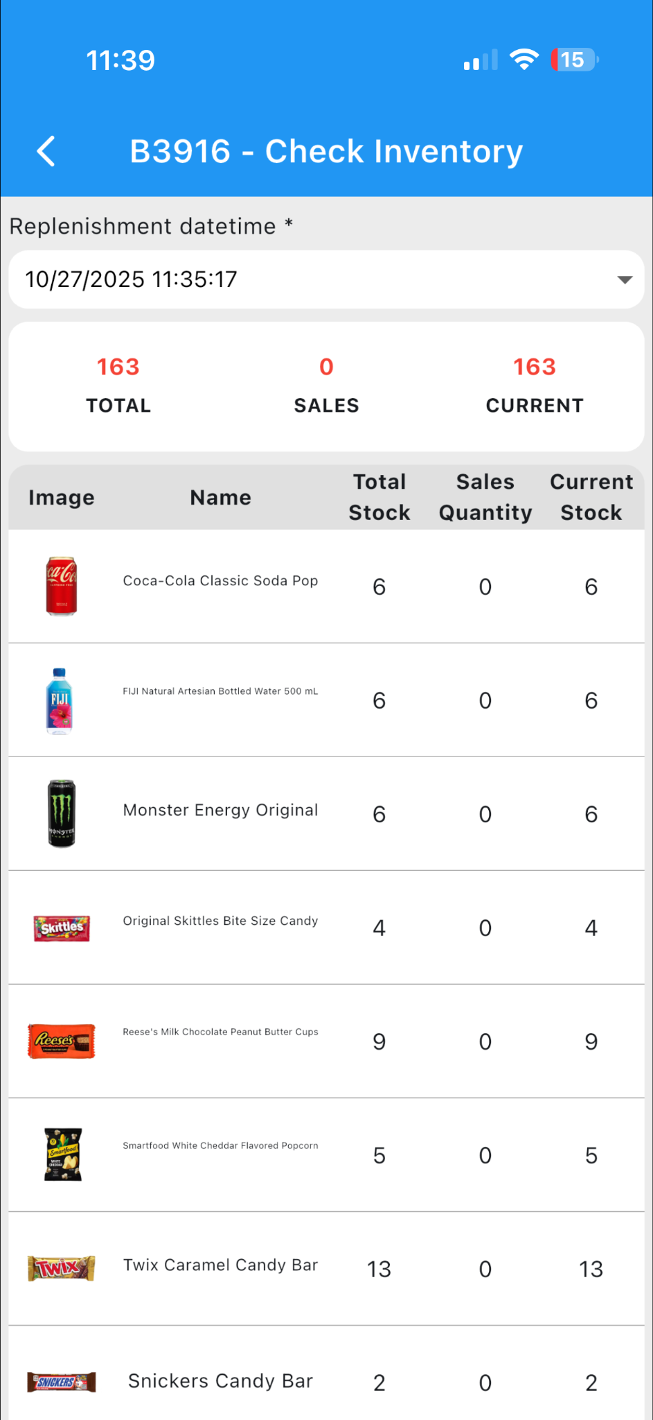
1.4.3 Viewing Replenishment Records
Purpose:
To review detailed records of each replenishment completed by restocking personnel.
Access Path:
App Home → Devices (bottom menu) → Select Target Device → Inventory
Description:
This page displays the replenishment history for the selected device (see Figure 1-4-3-1).
By default, the most recent replenishment record is shown.
At the top of the screen, you can select a specific replenishment date to filter and view records for that time period.
Each record includes product details based on the planogram template used during replenishment, along with key data metrics:
Total Stock: Total quantity of each item after replenishment.
Sales Quantity: Number of items sold since the last restock.
Current Stock: Current remaining inventory for each product.
Figure 1-4-3-1 Inventory records

Slide 8
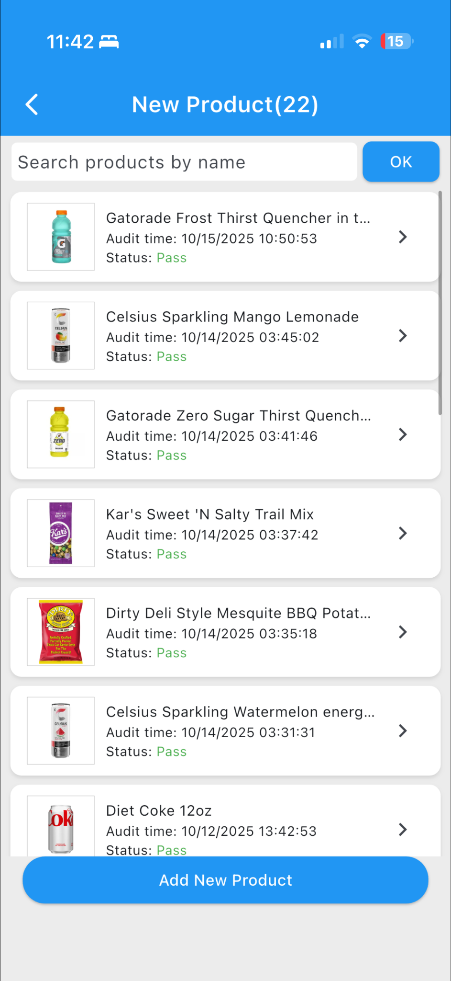
1.5 Product Applications
If the product a merchant intends to sell is not available in the cloud product library, they can submit an application to add it.
To apply:
Provide the required product information and upload photos of the product from multiple angles.
Submit the application for platform review.
Once the product is approved, it can be added to the planogram template and made available for sale through the device.
The Product Application entry point is “Add Item” to open the Product Application Page (Figures 1-3-1-3).
After selecting it, you’ll be taken to the Product Application List (Figure 1-5-2), where you can view all your submitted applications and their review statuses.
Figure 1-3-1-3 Product application
Figure 1-5-2 Product application record

Slide 9
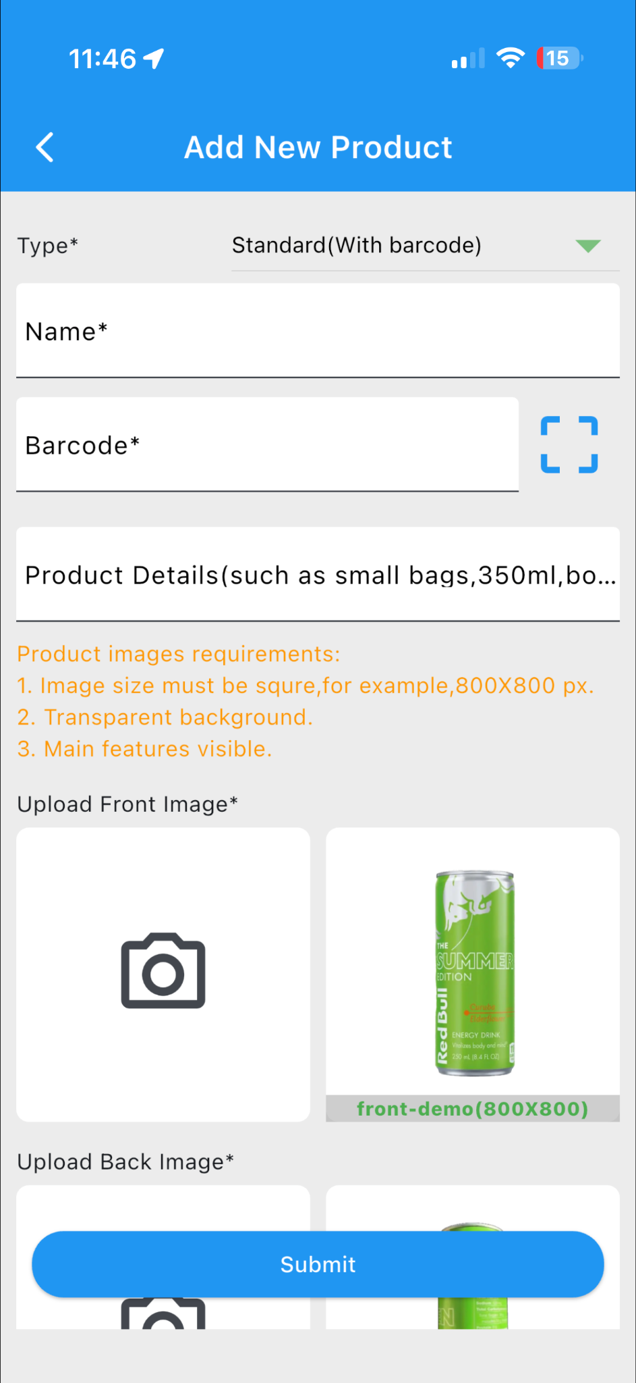
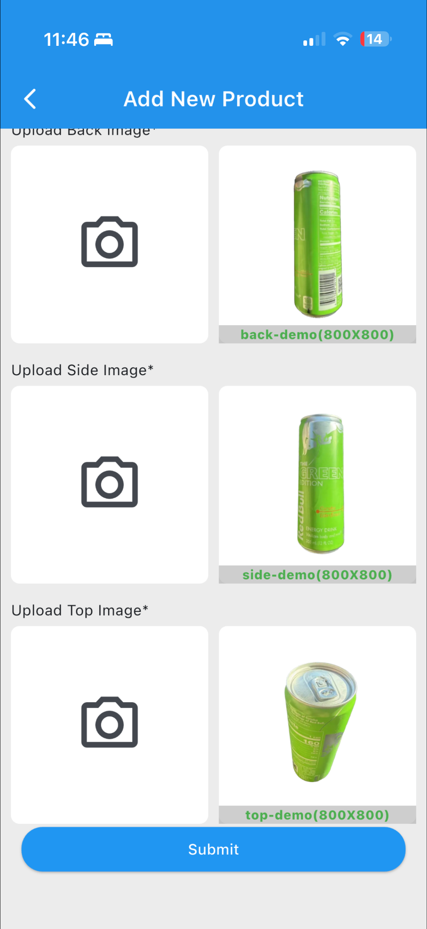
To add a new product:
Fill in the required product parameters and tap “Submit” to complete your application.(Figures 1-5-3 and 1-5-4).
The platform will then review your submission — please wait for the approval before proceeding.
Figure 1-5-3 Product applications Figure 1-5-4 Product applications

Slide 10
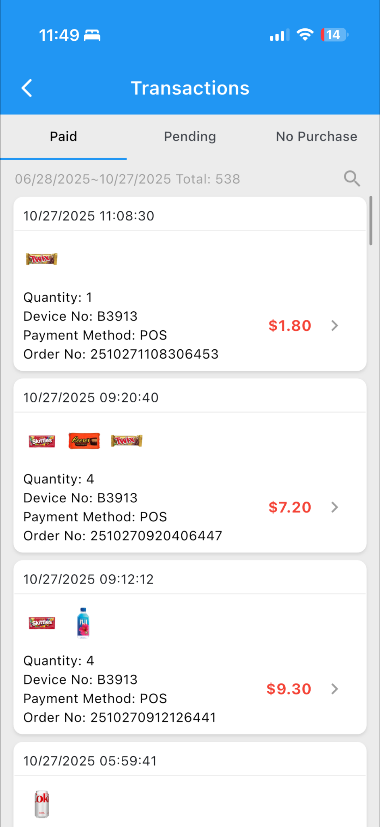
Transaction Orders
2.1 Transaction lists
After a consumer completes a purchase on the machine, the transaction data, generated by the system’s algorithm, will be displayed on this page.
Access Path:
Tap the “Transactions” icon on the app’s home page (Figure 2-1-1) to open the Order List page (Figure 2-1-2).
On the Transaction page, orders can be filtered by payment status:
* Paid: Orders that have been successfully paid.
* Pending: Orders that are (unpaid/partial paid).
* No Purchase: Orders where the consumer opened the machine but did not pick up any items.
By default, the list displays orders from the last 4 months.
To customize the search:
Tap the search icon in the upper-right corner.
Filter orders based on custom time ranges, order number, or device number according to your needs.
Figure 2-1-1 Transaction Figure 2-1-2 Order list page

Slide 11
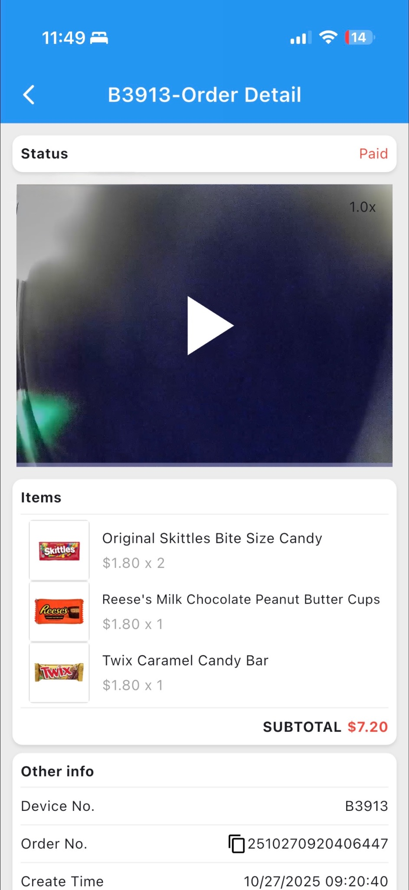
2.2 Order Details
Tap a specific order in the Order List to open the Order Details page (Figure 2-2-1).
On this page, you can:
View the video of the consumer’s shopping session.
Check the details of the purchased items, including quantities and product information.
Figure 2-2-1 Order details page

Slide 12
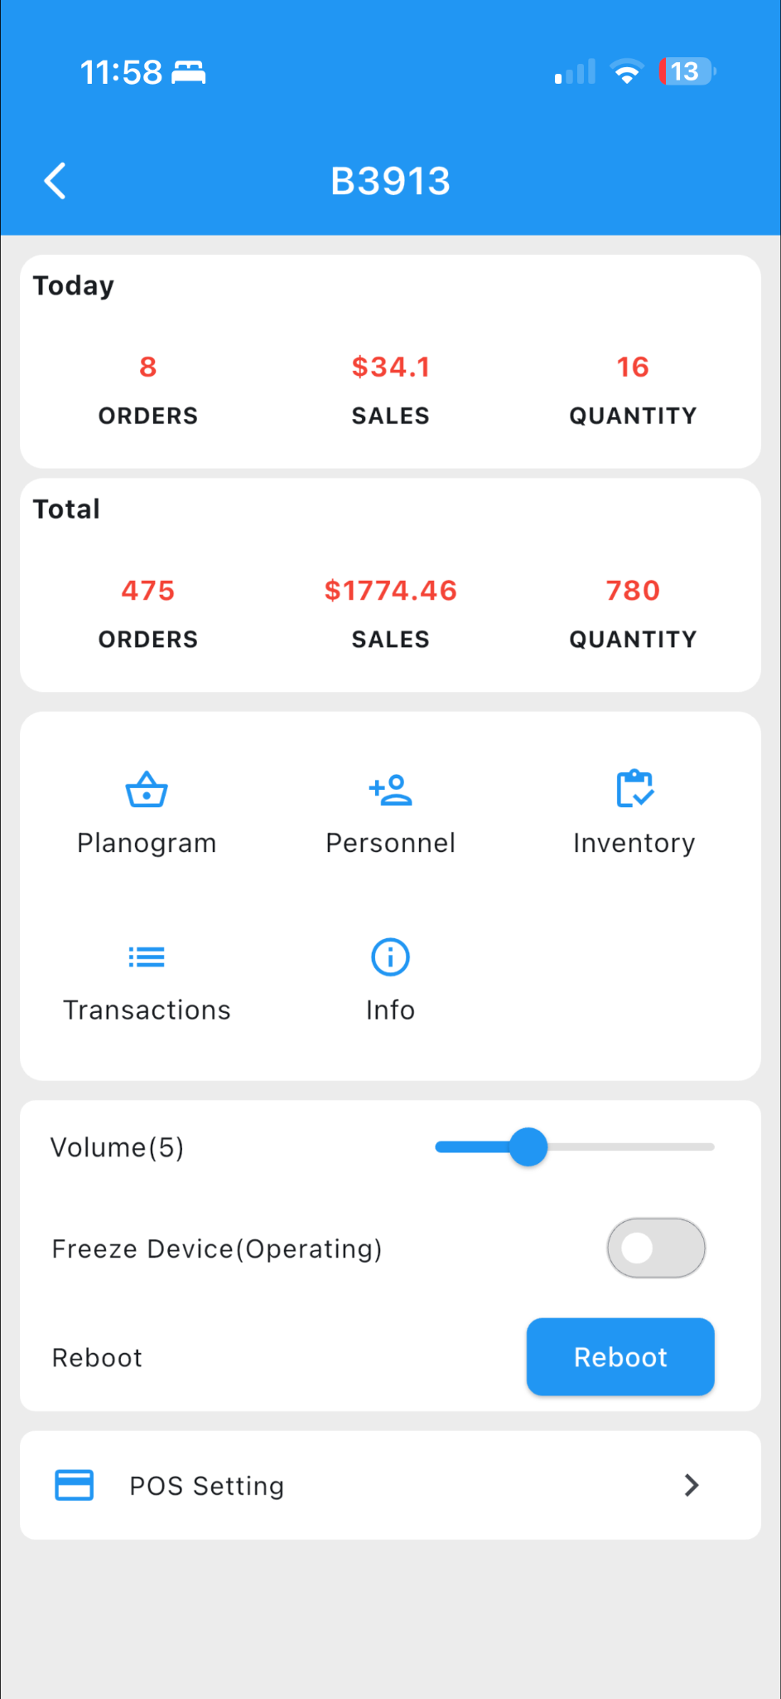
Data Statistics
3.1 Merchant Statistics
The TODAY section on the app’s home page (Figure 3-1-1) displays merchant-level statistics:
ORDERS: Total number of orders for the merchant today.
SALES: Total sales amount for the merchant today.
DEVICES: Number of devices online / total for the merchant.
3.2 Device Statistics
Tap “Devices” at the bottom of the app’s home page to open the Device List page.
Select a specific device to enter its Device Home Page (Figure 3-2-1).
At the top of this page, the Today and Total sections display the device’s daily and cumulative statistics:
ORDERS: Number of orders.
SALES: Total sales amount.
QUANTITY: Total number of items sold.
Figure 3-1-1 Today's statistics Figure 3-2-1 Equipment home page

Slide 13
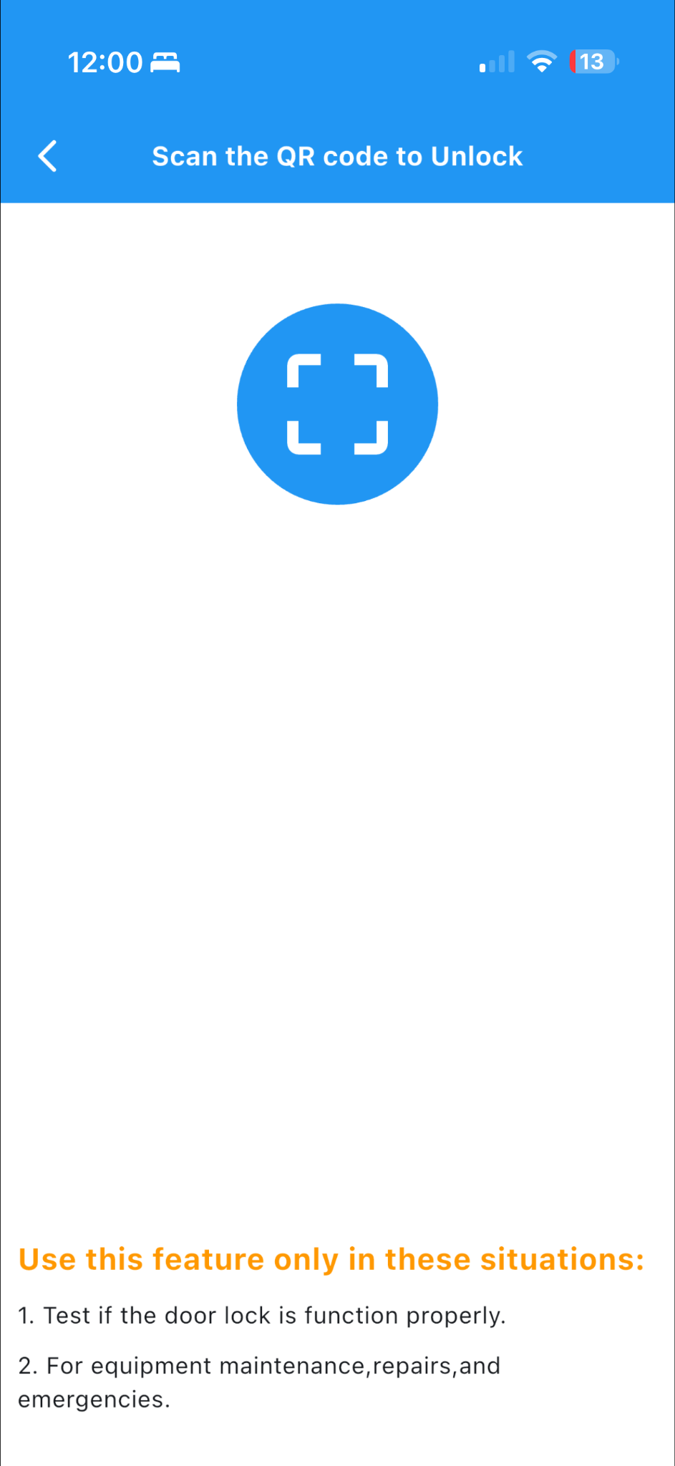
4.1 Unlock
Usage:
The Super Tube Lock function is primarily used to check whether the device’s electromagnetic lock can open and close normally, or to open the door in emergency situations.
Note: This function does not check the device template or related configuration and does not generate any order information.
Access Path:
App Home Page → Unlock (Figure 4-1-1)
Operation Steps:
Tap the “Unlock” button to enter the Scan Page (Figure 4-1-2).
Tap the Scan icon and scan the QR code on the device. (Figure 1-1-1) Equipment QR code
Once scanned, the door can be opened manually.
Figure 4-1-2 Scan page
Figure 4-1-1 Unlock Button
Figure 1-1-1 Equipment QR code

Slide 14
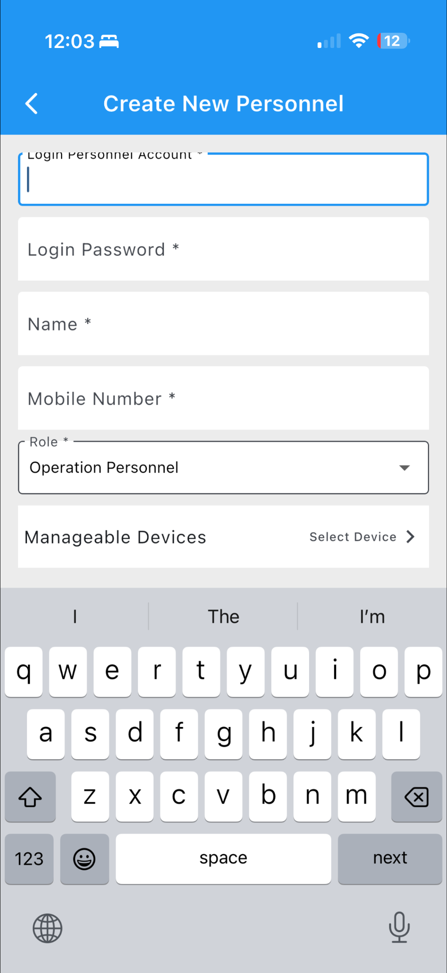
4.2 Home Page Announcements
The top section of the app’s home page displays the latest notifications for the user.
4.3 Personnel Allocation
Purpose:To add operator and restocker accounts.
Access Path:
App Home Page → Personnel
Operation Steps:
The list page displays all existing accounts.
Tap the “Add” button to open the Create Personnel page (Figure 4-3-1).
Enter the required information:
Account Name
Password
Mobile Number
Select the role for the new account.
Assign the devices the personnel can manage.
Complete the form and tap “Save” to add the new account.
Figure 4-3-1 Create a personnel page

Slide 15
4.4 Configuration
Access Path:
Tap “Devices” at the bottom of the app’s home page to open the Device List.
Select a specific device to enter its Device Profile Page (Figure 4-4-1).
Available Configuration Options:
Volume: Adjust the device’s audio level.
Freeze Device (Operating): Enable freeze mode, which locks the device and prevents door access for shopping.
Reboot: Perform a soft restart of the device.
Note: Rebooting may temporarily disconnect the device from the network.
POS Setting: Configure the device’s pre-authorized transaction amount.
Figure 4-4-1 Equipment home page

Slide 16
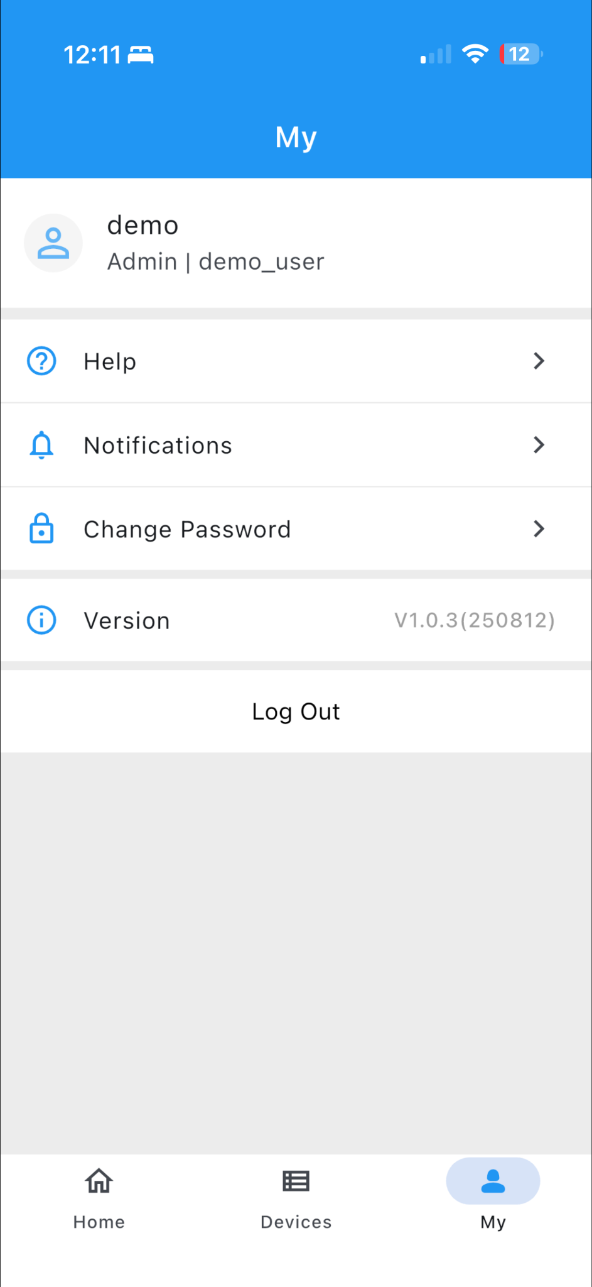
4.5 Personal Center
Access Path:
App → My
4.5.1 Help
Tap “Help” to view the list of frequently asked questions (FAQs).
4.5.2 List of Announcements
Tap “Notifications” to access the Announcements List, which displays all historical announcements posted by the merchant.
Figure 1-5-3 Product applications

Slide 17
4.5.3 Change Password
To update your login password:
Tap “Change Password”.
Enter your current password, new password, and confirm the new password.
Tap Submit to save the changes.
4.5.4 Log Off
To log out of the app, tap “Log Out”. This will end the current session and return you to the login screen.
Figure 1-5-3 Product applications

Slide 18
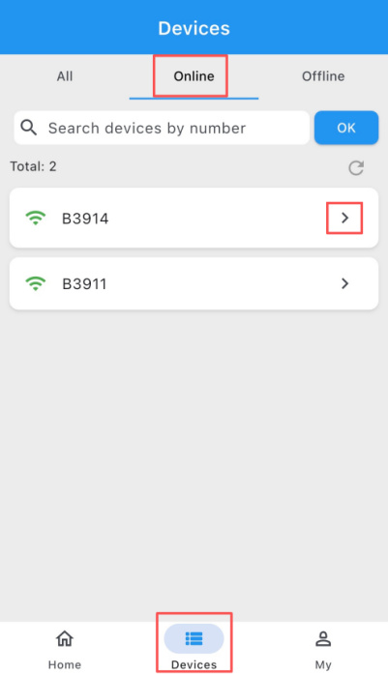
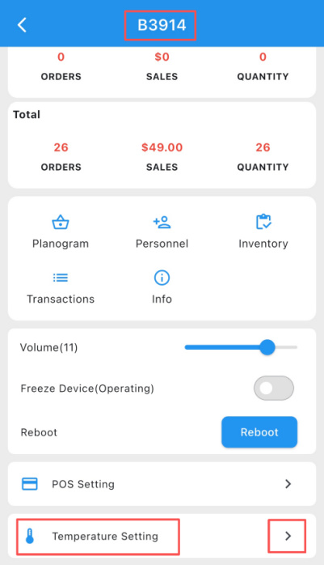
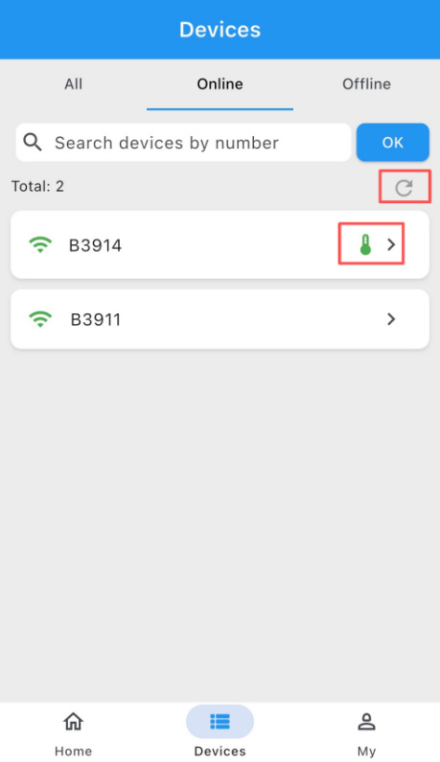
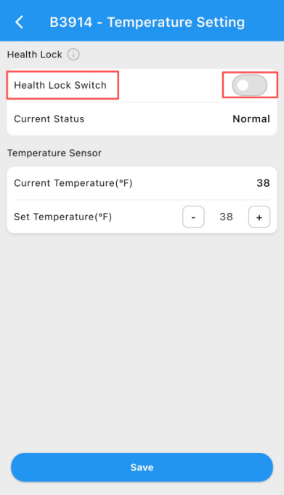
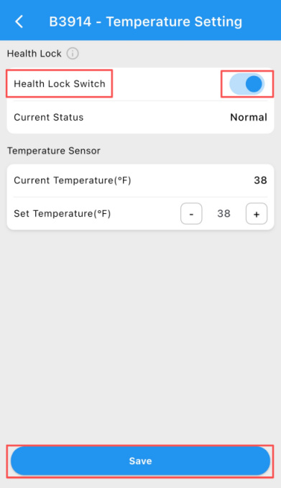
Health Lock Setup
1. Enabling Health Lock
Open the Merchant App. In the Devices module, select the device you want to enable (see Figure 1-1), and enter the device page.
Go to Temperature Settings (see Figure 1-2).
Turn on the Health Lock switch (see Figure 1-3).
On the Health Lock page, you can also set the desired temperature threshold.
After configuration, tap Save to apply the settings (see Figure 1-4).
Figure 1-1 Device Selection
Figure 1-2 Temperature Settings Entry
Figure 1-5 Device Status after Refreshment
Return to the Devices module and tap the Refresh button (see Figure 1-5).
A temperature icon will appear next to the device, indicating that Health Lock has been successfully enabled.
Figure 1-3 Health Lock Switch
Figure 1-4 Temperature Configuration

Slide 19

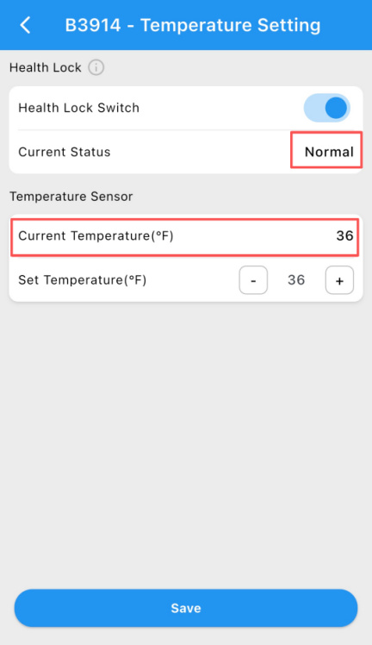
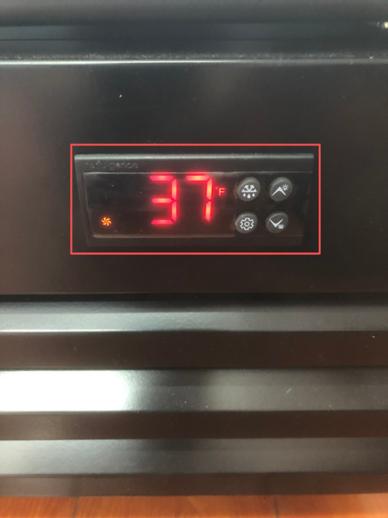
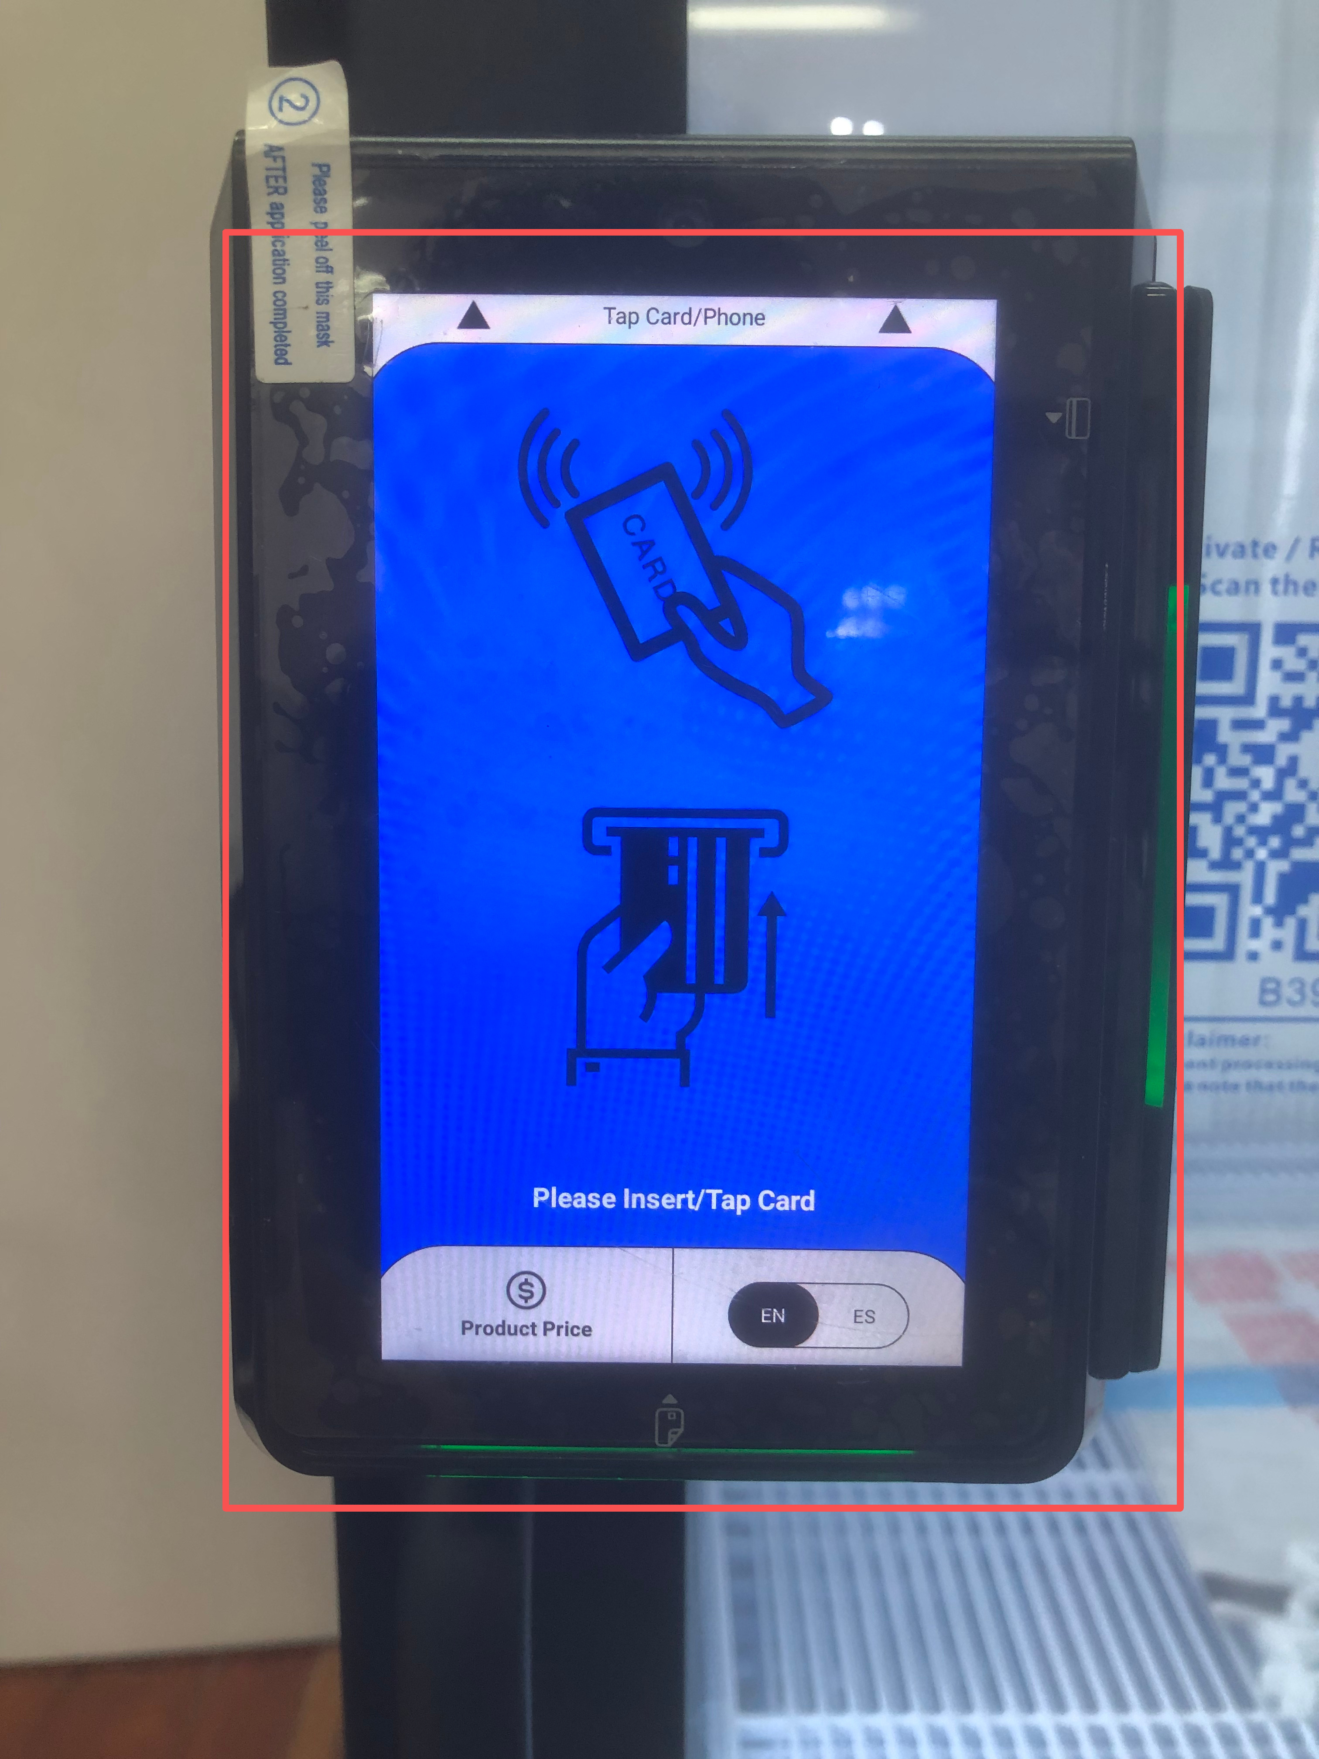
2.1 NORMAL — Normal Status
Temperature Range:≤ 41°F (5°C)
When the temperature is below 41°F, the following behaviors apply:
The device icon in the App will display a green temperature indicator (see Figure 2-1).
In the App, the Temperature Status will be shown as “Normal” (see Figure 2-2).
The Screen will display the device’s real-time temperature reading (see Figure 2-3).
The POS screen will operate normally and display the standard interface (see Figure 2-4).
Figure 2-1 Health Lock Indicator
Figure 2-2 Health Lock Status (Normal)
Figure 2-3 Real-Time Device Temperature
Figure 2-4 POS Interface (Normal Operation)

Slide 20

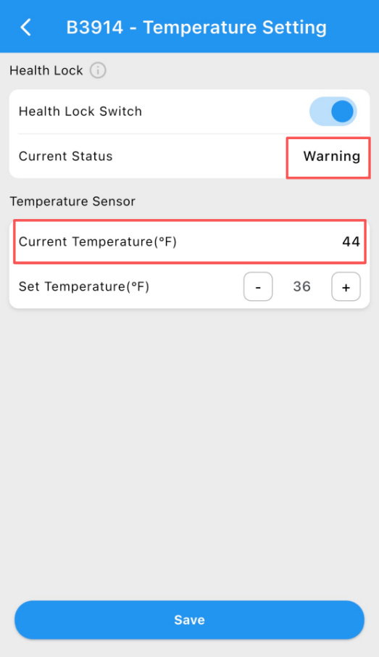
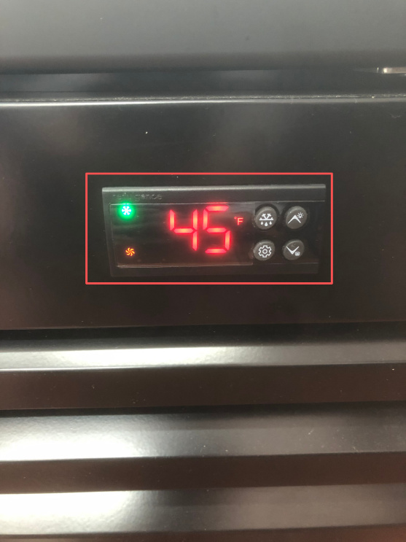
2.2 WARNING — Warning Status
Temperature Range: 41°F – 45°F (5°C – 7°C)
When the temperature is between 41°F and 45°F, the following behaviors apply:
The device icon in the App will display a yellow temperature indicator (see Figure 2-2-1).
In the App, the Health Lock Status will be shown as “Warning” (see Figure 2-2-2).
The App will display the device’s real-time temperature reading (see Figure 2-2-3).
The POS screen will display the initial operation interface and remain accessible (see Figure 2-2-4).
Figure 2-2-1 Health Lock Indicator (Warning)
Figure 2-2-2 Health Lock Status (Warning)
Figure 2-2-3 Real-Time Device Temperature
Figure 2-2-4 POS Interface (Initial Operation Screen)

Slide 21
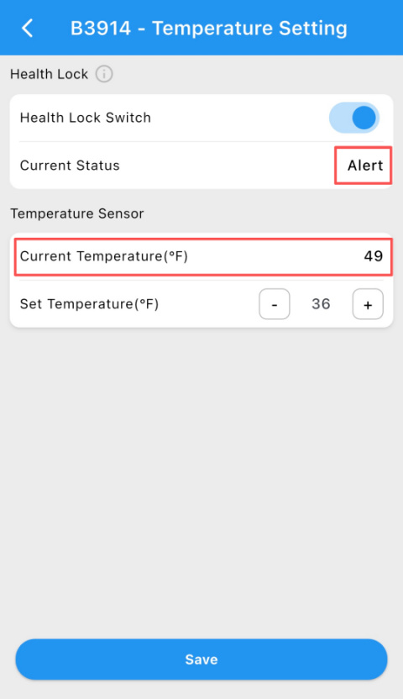
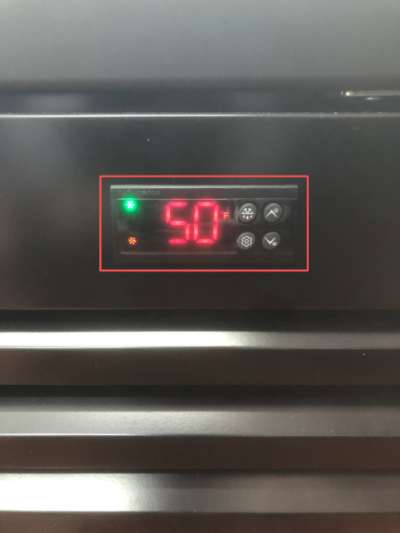
2.3 ALERT — Alert Status
Temperature Range: > 45°F (7°C)
Duration: Less than 2 hours
When the temperature exceeds 45°F but the duration is less than 2 hours, the system enters Alert status, and the following behaviors apply:
The device icon in the App will display an orange temperature indicator (see Figure 2-3-1).
In the App, the Health Lock Status will be shown as “Alert” (see Figure 2-3-2).
The App will display the device’s real-time temperature reading (see Figure 2-3-3).
The POS terminal will remain operational and display the standard operation interface (see Figure 2-3-4).
Figure 2-3-1 Health Lock Indicator (Alert)
Figure 2-3-2 Health Lock Status (Alert)
Figure 2-3-4 POS Interface (Operational)
Figure 2-3-3 Real-Time Device Temperature

Slide 22
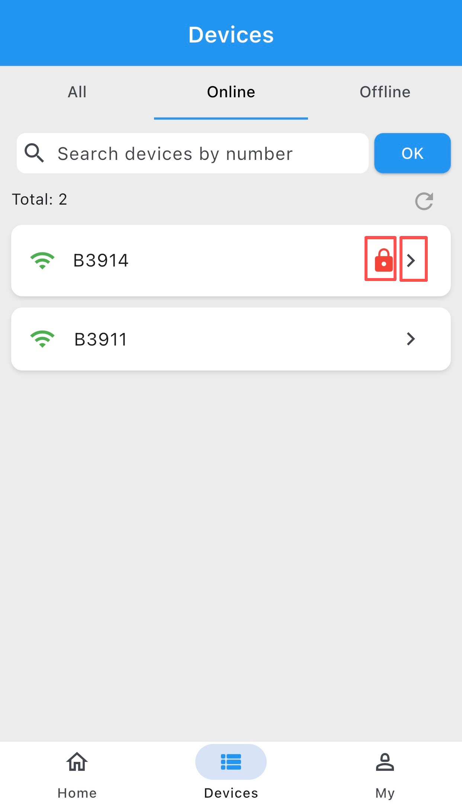
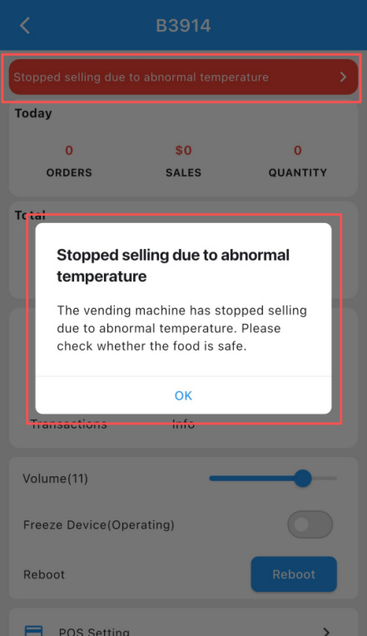
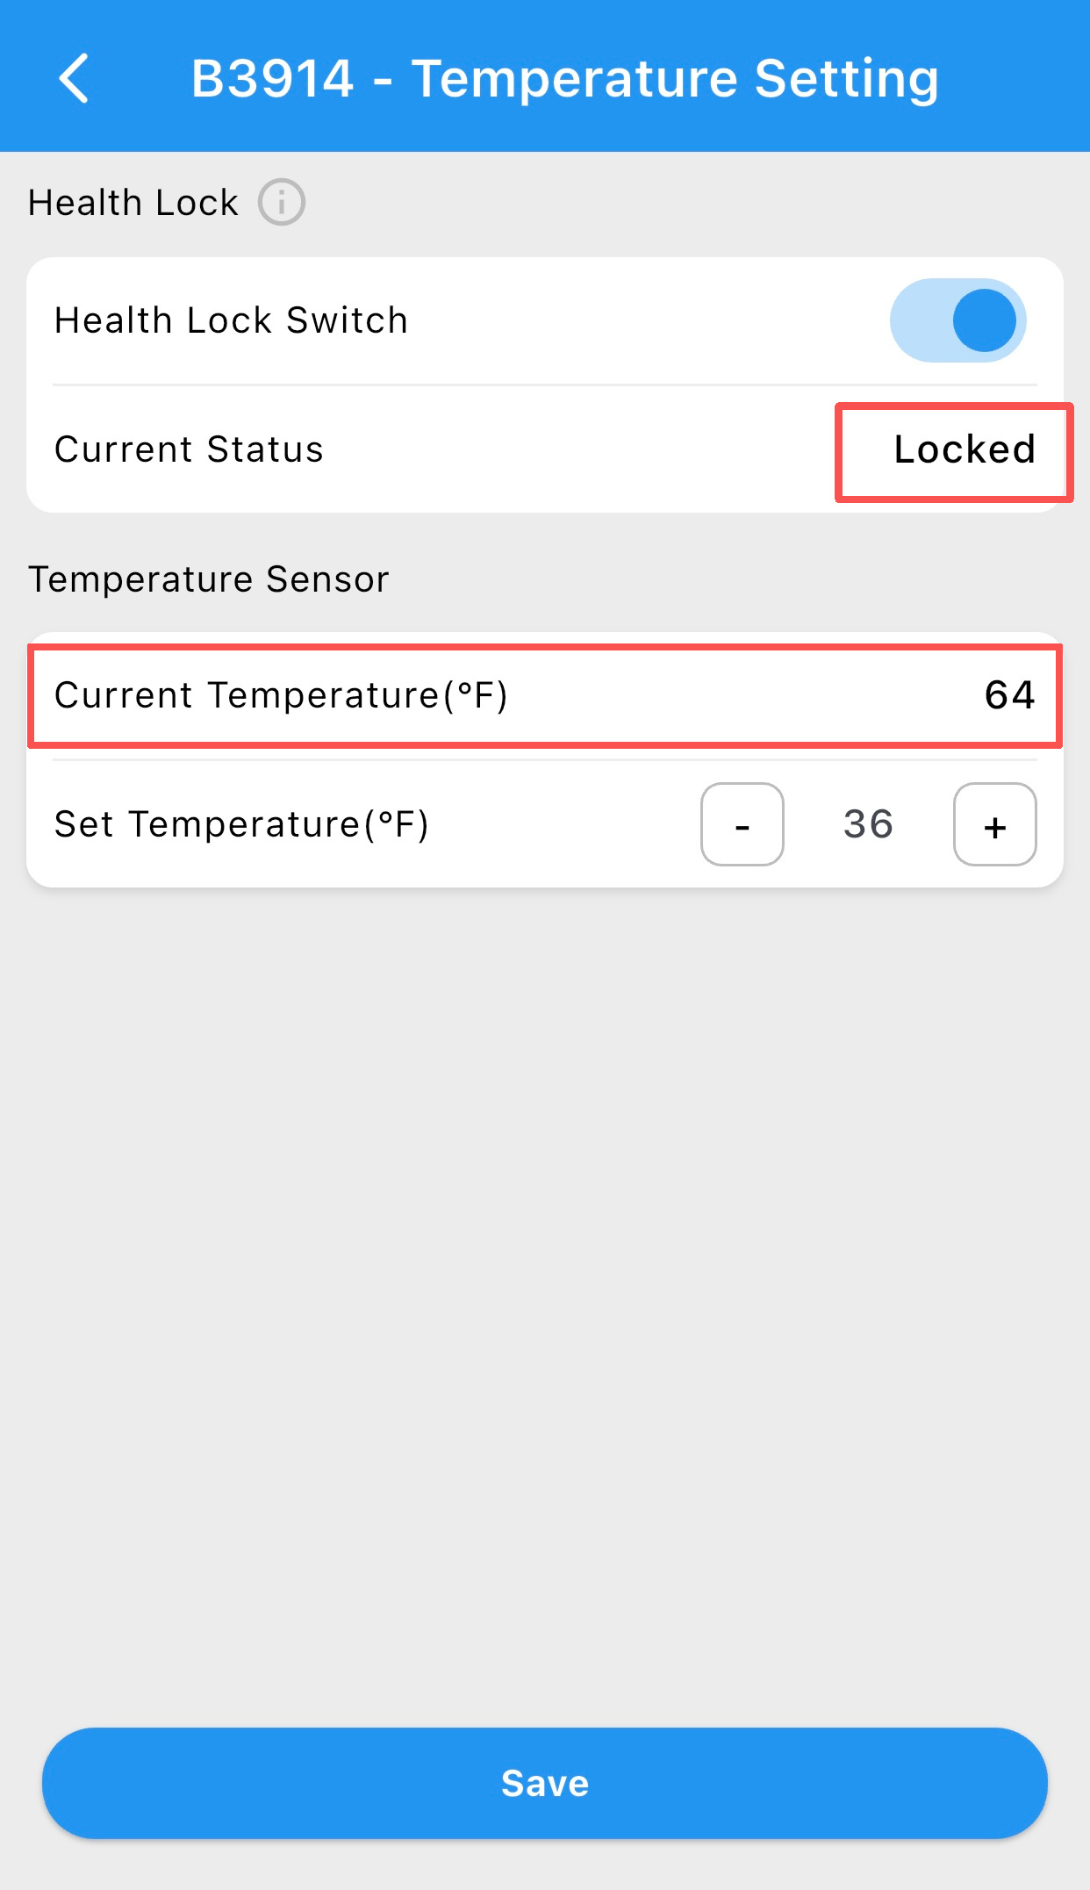
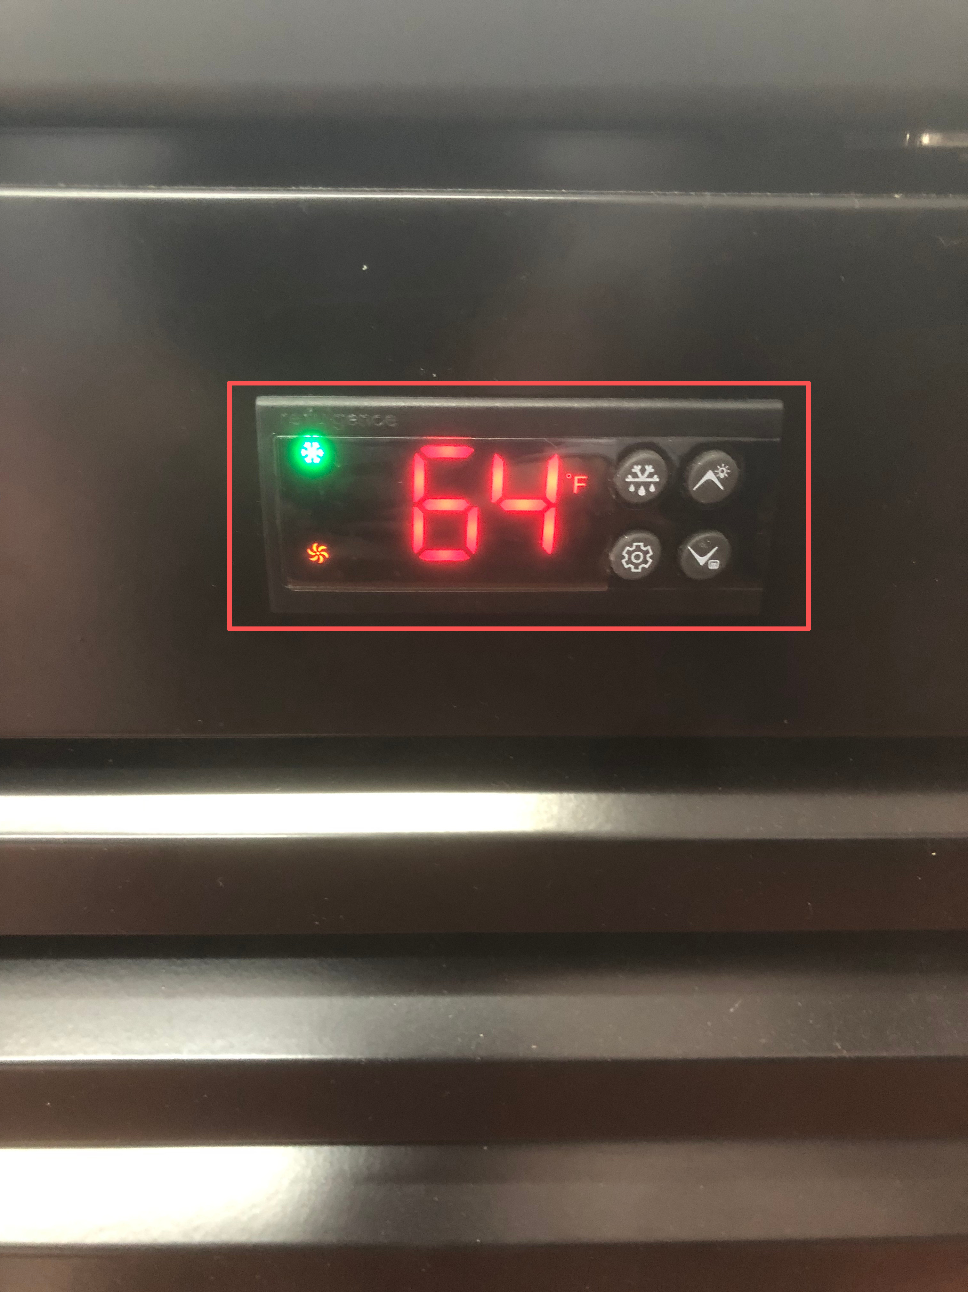
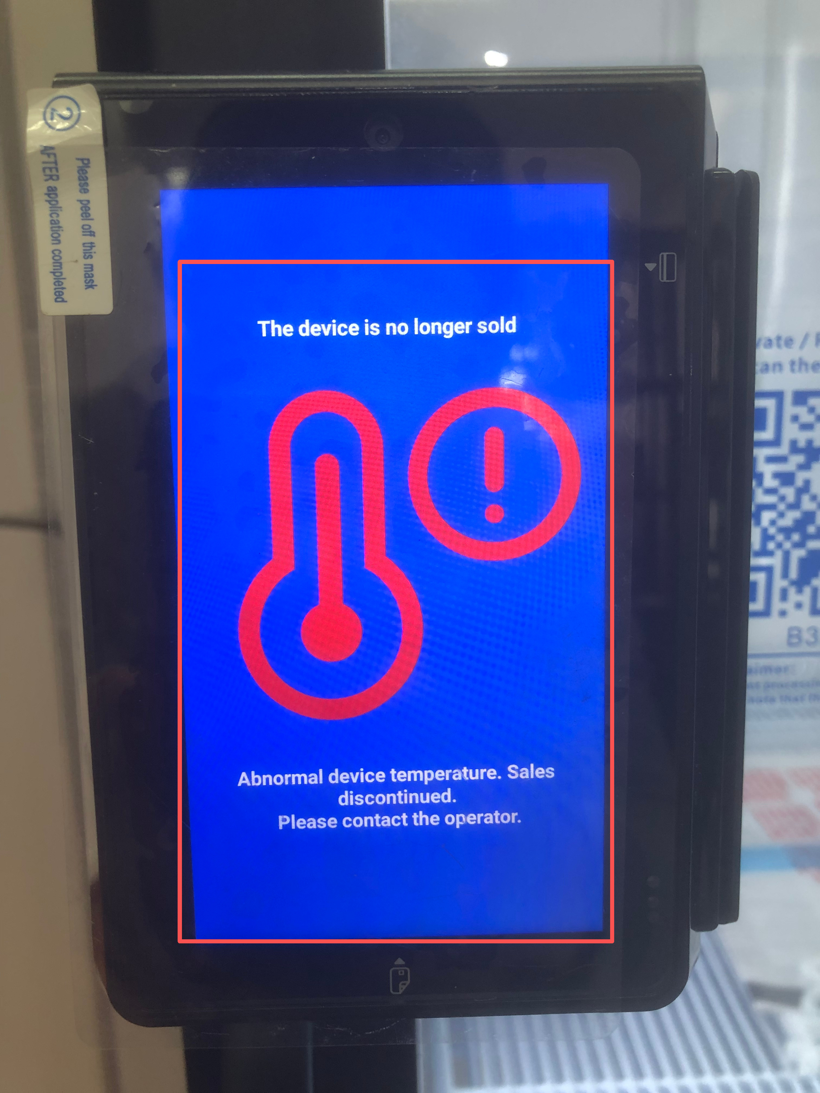
2.4.1 LOCKED — Locked Status
Temperature Threshold: > 45°F (7°C)
Duration: More than 2 hours
When the temperature exceeds 45°F for a continuous period longer than 2 hours, the system enters Locked status, and the following behaviors apply:
The device icon in the App will display a red temperature indicator (see Figure 2-4-1-1).
The App will display a sales suspension alert indicating that selling has been stopped due to abnormal temperature (see Figure 2-4-1-2).
In the App, the Health Lock Status will be shown as “Locked”, and the device’s real-time temperature will be displayed (see Figure 2-4-1-3 and Figure 2-4-1-4).
Figure 2-4-1-1 Health Lock Indicator (Locked)
Figure 2-4-1-2 App Alert: Sales Stopped Due to Abnormal Temperature
Figure 2-4-1-5 POS Interface (Sales Disabled)
Figure 2-4-1-4 Real-Time Device Temperature
The POS screen will display a sales disabled interface, indicating that the device is no longer allowed to sell products (see Figure 2-4-1-5).
Figure 2-4-1-3 Health Lock Status (Locked)

Slide 23
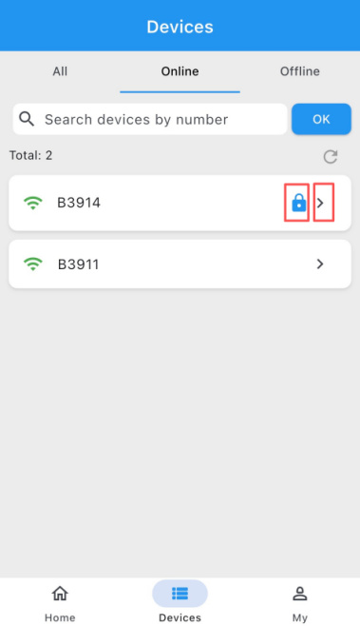
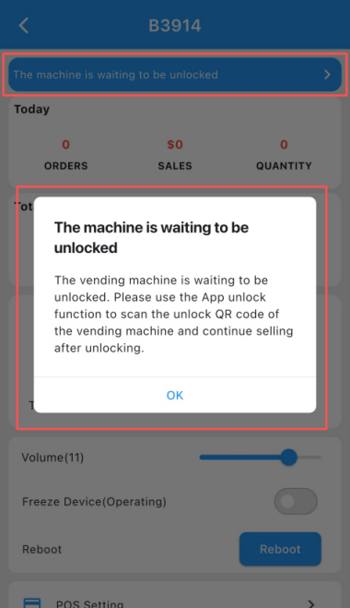
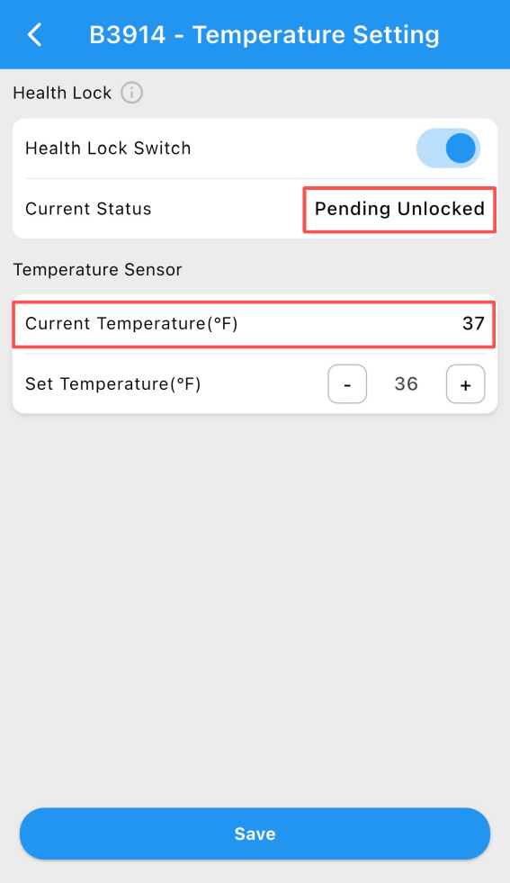
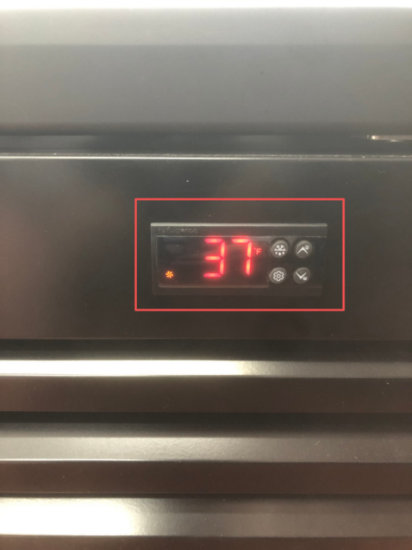
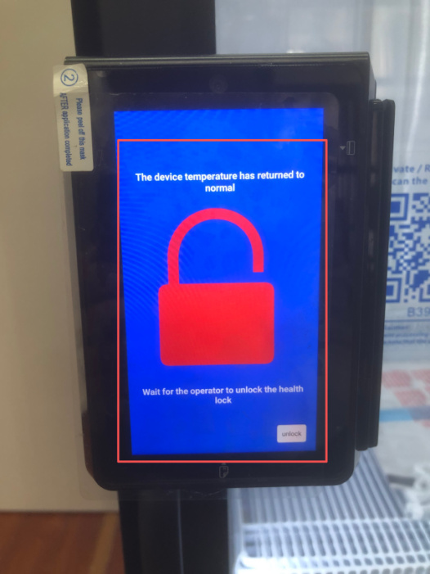
2.5 PENDING_UNLOCKED — Pending Unlock Status
Temperature Condition: Temperature has recovered to < 41°F (5°C)
Duration: More than 30 minutes
When the temperature drops below 41°F and remains stable for more than 30 minutes, the system enters Pending Unlock status, and the following behaviors apply:
The device icon in the App will display a blue lock indicator (see Figure 2-5-1).
The App will display a pending unlock alert, indicating that the device is waiting to be unlocked (see Figure 2-5-2).
In the App, the Health Lock Status will be shown as “Pending Unlocked”, along with the device’s real-time temperature reading (see Figure 2-5-3 and Figure 2-5-4).
The POS screen will display a pending unlock interface, indicating that the device has not yet been fully unlocked and sales are still restricted (see Figure 2-5-5).
Figure 2-5-1 Health Lock Indicator (Pending Unlock)
Figure 2-5-2 App Alert: Pending Unlock
Figure 2-5-5 POS Interface (Pending Unlock)
The POS screen will display a pending unlock interface, indicating that the device has not yet been fully unlocked and sales are still restricted (see Figure 2-5-5).
Figure 2-5-3 Health Lock Status (Pending Unlocked)
Figure 2-5-4 Real-Time Device Temperature

Slide 24
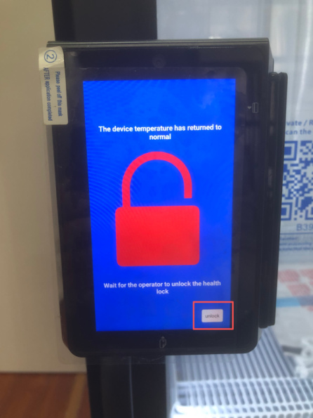
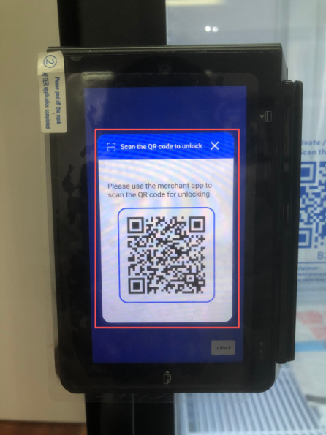
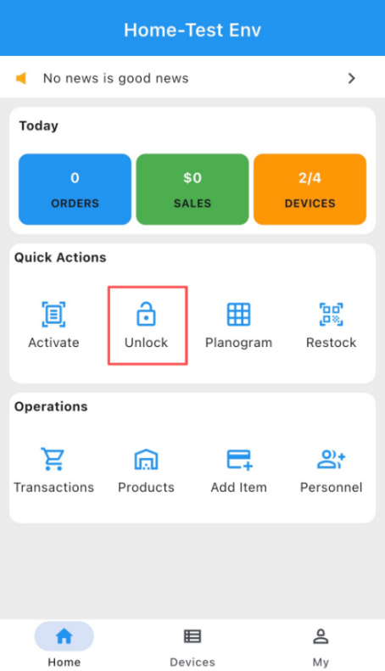
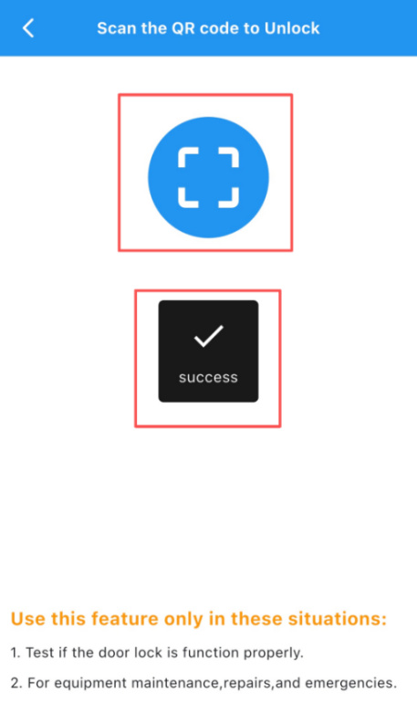
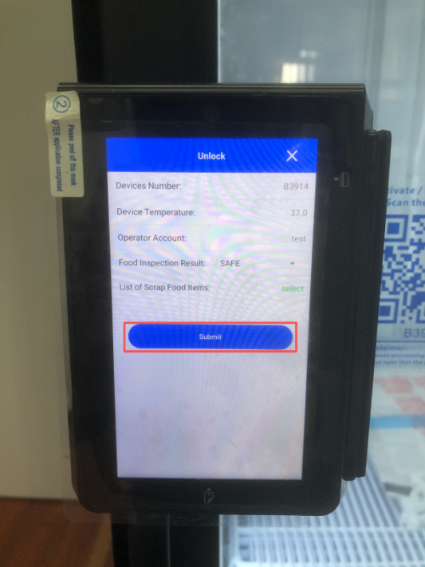
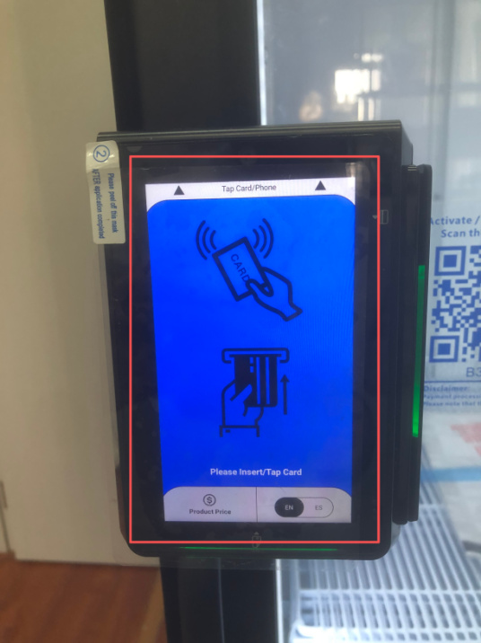
Chapter 3 Health Lock Unlock Procedure
3.1 Unlock from the POS Terminal
When the device is in Pending Unlock status, tap the Unlock button located at the bottom-right corner of the POS screen (see Figure 3-1-1). A QR code will then be displayed on the POS screen (see Figure 3-1-2).
3.2 Unlock via the Merchant App
Open the Merchant App and tap the Unlock button (see Figure 3-2-1).
Use the App to scan the QR code displayed on the POS terminal (see Figure 3-2-2).
Wait for the POS terminal to verify the unlock request.
After verification is completed, tap the Submit button in the App (see Figure 3-2-3).
Wait for the POS screen to return to the initial operation interface (see Figure 3-2-4).
Once the initial interface is displayed, the device has been successfully unlocked.
Figure 3-1-1 POS Interface – Unlock Button
Figure 3-1-2 Unlock QR Code Displayed on POS
Figure 3-2-1 App Unlock Entry
Figure 3-2-2 QR Code Scanning Confirmation
Figure 3-2-4 POS Interface – Initial Operation Screen (Unlocked)
Figure 3-2-3 Submit Unlock Request

